Slide 1


IMPROVING ADABOOST-BASED INTRUSION DETECTION SYSTEM PERFORMANCE ON CIC-IDS 2018 DATASET
22MIA1142 – SUJANA S
22MIA1159 – DAPHNI MICHELLE B
22MIA1167 – SREE DARSHNE J

Slide 2
Team members:
NAME & REG.NO | CONTRIBUTION | SIGNATURE
SUJANA S 22MIA1142 | Implementation of algorithm for feature selection, Making use of algorithm such as Principle component analysis and SMOTE and implementation of Ensemble Feature Selection Algorithm.
DAPHNI MICHELLE B 22MIA1159 | Implementation of Random forest for overfitting detection, Making use of Reinforcement learning Techniques and Bagging Technique.
SREE DARSHNE J 22MIA1167 | Implementation of Elastic Net Regression, Making use of Recurrent Neural Networks and implementation of Extreme Gradient Boosting for Classification Algorithm.

Slide 3
INTRODUCTION:
Intrusion Detection Systems (IDS) are essential in detecting and preventing any possible cyber incidents in a certain network system. However, the software architecture of conventional IDS has deficiencies in addressing various advancements in network traffic and upcoming threats. This paper aims to reconstruct an XGboost-based IDS using the CIC-IDS 2018 dataset and applies several optimization techniques that increase the detection rate.
The enhancements include performing feature engineering strategies such as Ensemble Feature Selection, dimensionality reduction and PCA, and data augmentation techniques like SMOTE. Machine learning techniques such as Elastic Net Regression; RNN; XGBoost ; Reinforcement learning, and Bagging are conjoined on conventional models in a bid to build a more flexible and stronger IDS system. The goal of this research is to develop the Intrusion Detection System which will be able to detect complex forms of attacks with minimum false decisions.

Slide 4
PROJECT WORKFLOW:
DATA PREPROCESSING
FEATURE SELECTION
BALANCING THE DATA
MODEL EVALUATION
ADVANCED MODELS
MODEL TRAINING

Slide 5
1. Data Preprocessing:
Load the CIC-IDS-2018 dataset.
Data Cleaning.
Data Encoding.
Normalization/Standardization.
2. Feature Selection:
PCA(Principal Component Analysis).
Ensemble Feature Selection.
3. Balancing the Data:
SMOTE(Synthetic Minority Oversampling Technique).
4. Model Training:
Elastic Net Regression.
Bagging using One Hot Encoder
AdaBoost.
5. Advanced Models:
XGBoost(Extreme Gradient Boosting).
ADABoost
RNN’s (Recurrent Neural Networks).
Reinforcement Learning.
6. Model Evaluation:
F1 Score.
Precision.
Recall
Confusion Matrix.

Slide 6
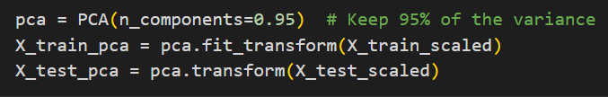

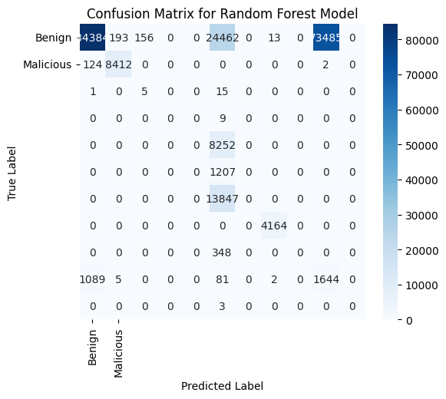
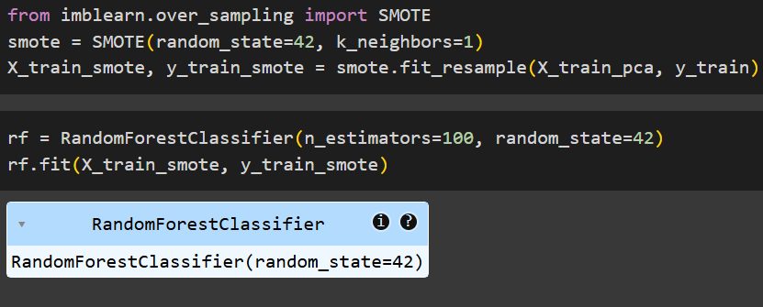
Implementation and Result:

Slide 7
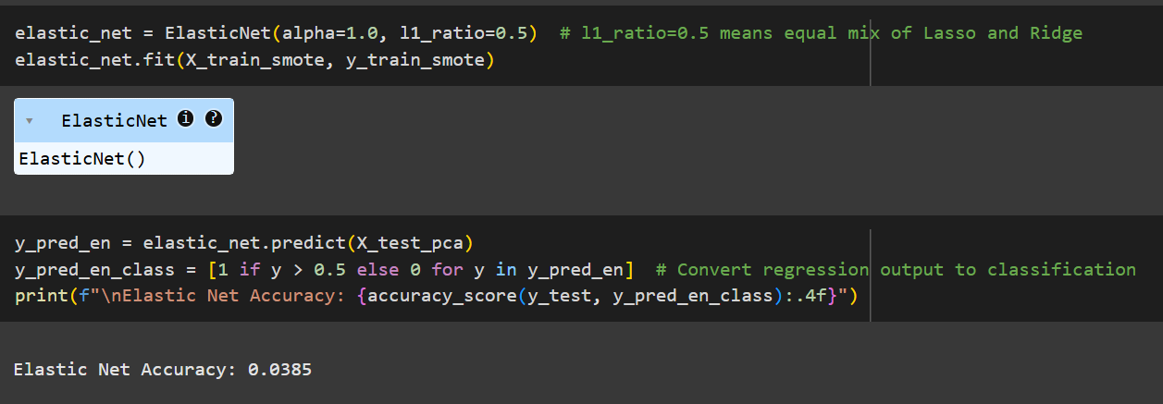
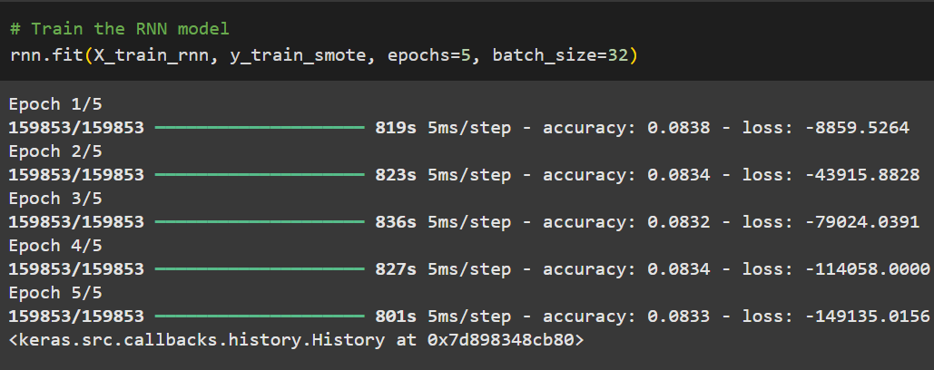
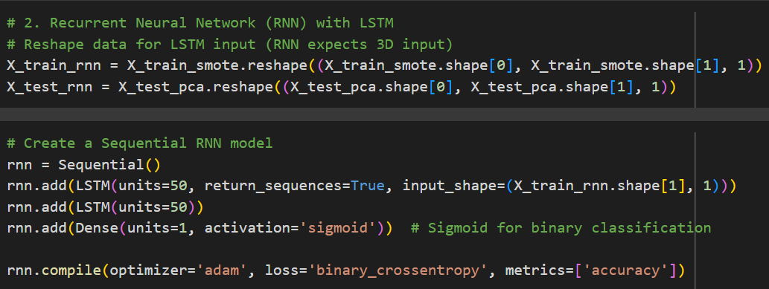

Slide 8
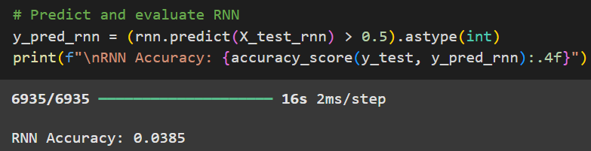
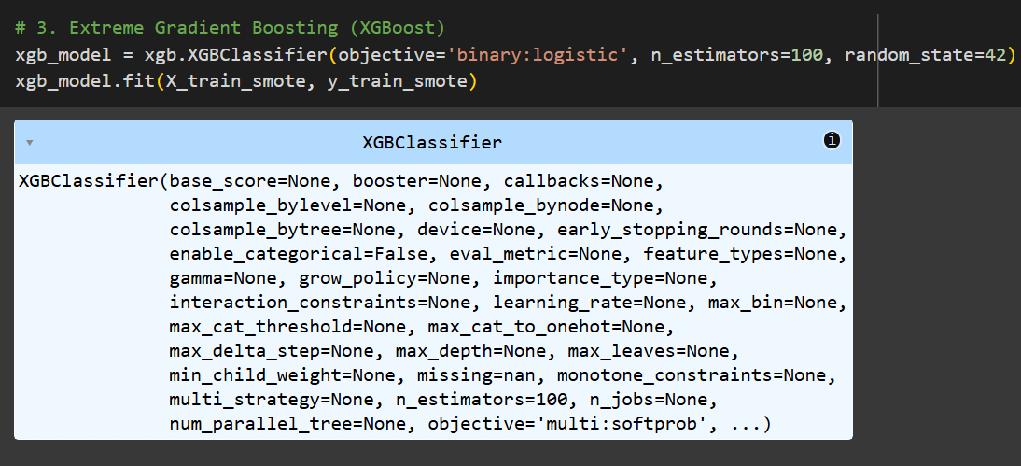

Slide 9
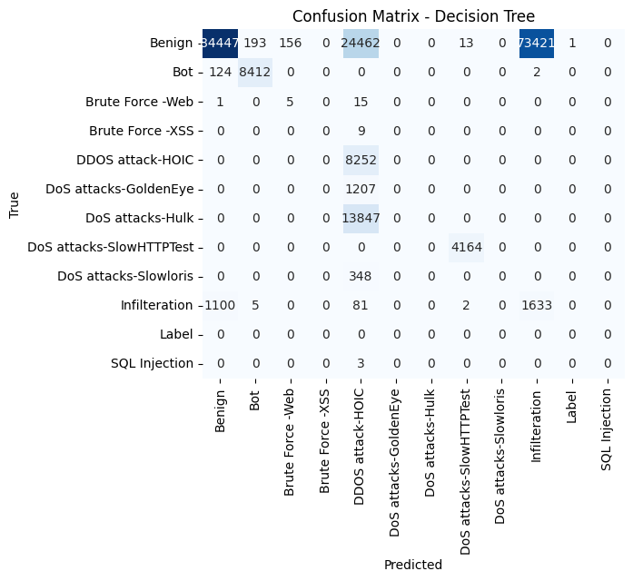
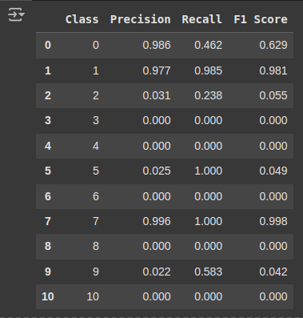

Slide 10
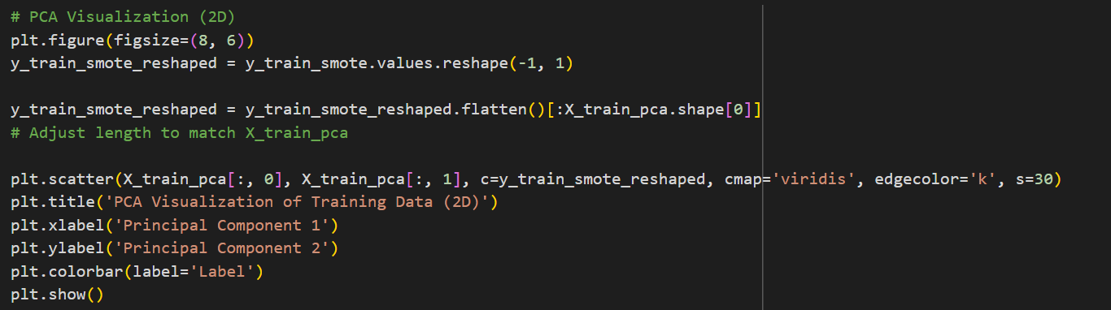
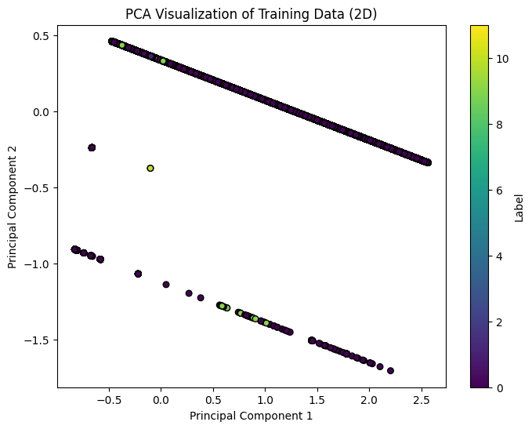

Slide 11
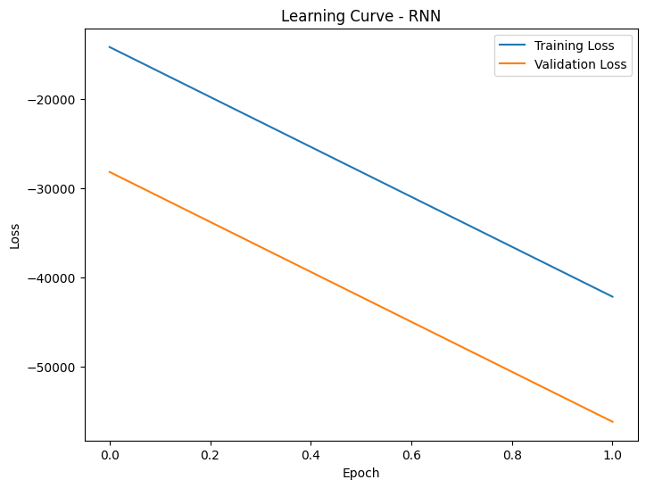
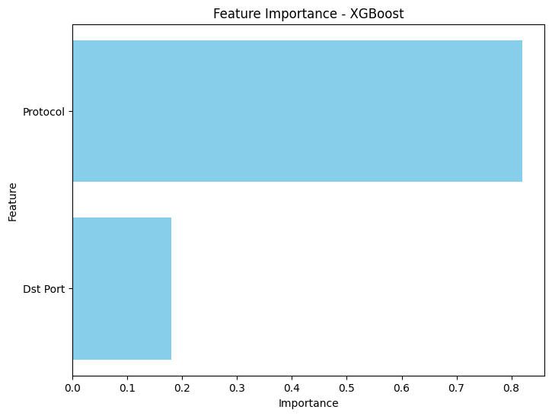

Slide 12
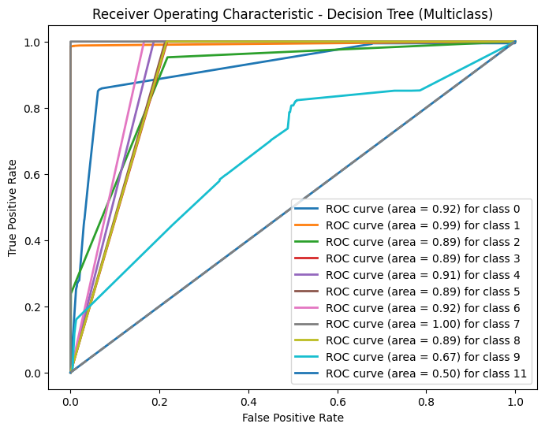

Slide 13
